Slide 1

GIT
Version Control System
Author: Daxil Shah

Slide 2
What is GIT?
Git is a type of version control system (VCS) that makes it easier to track changes to files. For example, when you edit a file, git can help you determine exactly what changed, who changed it, and why.
It’s useful for coordinating work among multiple people on a project, and for tracking progress over time by saving “checkpoints”.
Git isn’t the only version control system out there, but it’s by far the most popular.

Slide 3
How to get started?
Git comes installed by default on many systems. If you don’t already have it:
You can download git’s command-line interface (CLI) here. I recommended this for both beginners and advanced users.
If you prefer to use a fancy graphical user interface (GUI) instead, try GitHub Desktop. This will be simpler to use, but will make it more difficult to really see what’s going on.

Slide 4
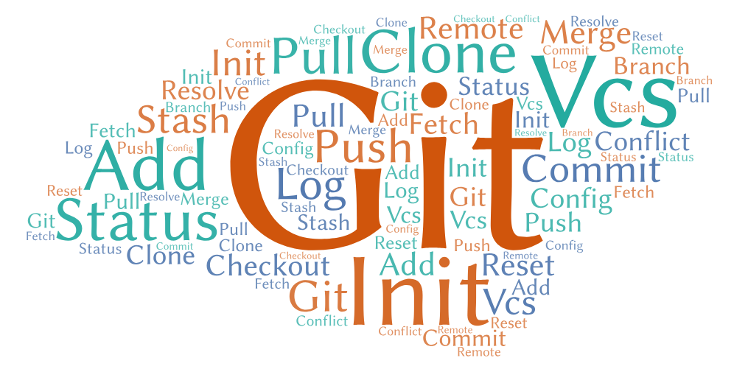
Common Commands
We will cover following commands during this session.
Init, Clone, Config, Status, Branch, Checkout, Diff, Add, Commit, Push, Pull, Merge, Remote, Log, Fetch, Reset, and Conflict Resolve

Slide 5
Initialize your working directory with GIT
This will create a hidden .git folder inside your current folder — this is the "repository" (or repo) where git stores all of its internal tracking data.
Any changes you make to any files within the original folder will now be possible to track.
The original folder is now referred to as your working directory, as opposed to the repository (the .git folder) that tracks your changes.
> git init

Slide 6
Clone an existing Repository
This will download a .git repository from the internet to your computer and extract the latest snapshot of the repo (all the files) to your working directory.
By default it will all be saved in a folder with the same name as the repo
The URL you specify here is called the remote origin (the place where the files were originally downloaded from).
> git clone https://github.com/bacancy/staffplan.git

Slide 7
GIT Configurations
We can view or modify the existing configuration either at local project level or global level.
These configuration levels correspond to .git/config text file.
Using Command Line (Terminal)
> git config user.name
> git config --global user.name

Slide 8
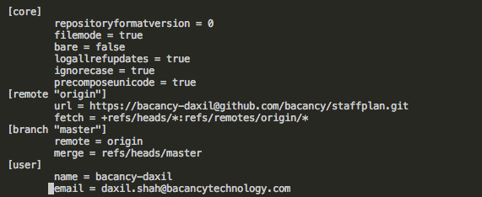
GIT Configurations (Continued)
Changing .git/config file.

Slide 9
View Current Status of your Project
This will print some basic information, such as which files have recently been modified.
You should check your status anytime you’re confused. Git will print additional information depending on what’s currently going on in order to help you out.
> git status

Slide 10
Create a new branch
You can think of this like creating a local “checkpoint” (technically called a reference) and giving it a name.
It’s similar to doing File > Save as… in a text editor; the new branch that gets created is a reference to the current state of your repo.
> git branch <branch_name>
OR
> git checkout -b <branch_name> (This will create a new branch and will switch to it)

Slide 11
Fetch all remote branches
The git fetch command downloads commits, files, and refs from a remote repository into your local repo.
Fetching is what you do when you want to see what everybody else has been working on.
When downloading content from a remote repo, git pull and git fetch commands are available to accomplish the task. You can consider git fetch the 'safe' version of the two commands. It will download the remote content but not update your local repo's working state, leaving your current work intact.
> git fetch --all

Slide 12
Checkout a particular branch
You can think of this like “resuming” from an existing checkpoint. All your files will be reset to whatever state they were in on that particular branch.
> git checkout <branch_name>
OR
> git checkout -b <branch_name> (This will create a new branch and will switch to it)

Slide 13
Stage your changes to prepare for commit
After editing some files, this command will mark any changes you’ve made as “staged” (or “ready to be committed”).
If you then go and make more changes, those new changes will not automatically be staged, even if you’ve changed the same files as before. This is useful for controlling exactly what you commit
If you’re ever unsure, just type git status again to see what’s going on. You’ll see “Changes to be committed:” followed by file names in green. Below that you’ll see “Changes not staged for commit:” followed by file names in red. These are not yet staged.
> git add <file_names_separated_by_space> OR
> git add my_project/css/*

Slide 14
Commit your staged changes
This command will move all your staged changes to the HEAD locally. This is often called as Ready to Push state.
> git commit
This will open your default command-line text editor and ask you to type in a commit message. As soon as you save and quit, your commit will be saved locally.
OR
You can use the -m flag as a shortcut to write a message.
> git commit -m “Commit Message”

Slide 15
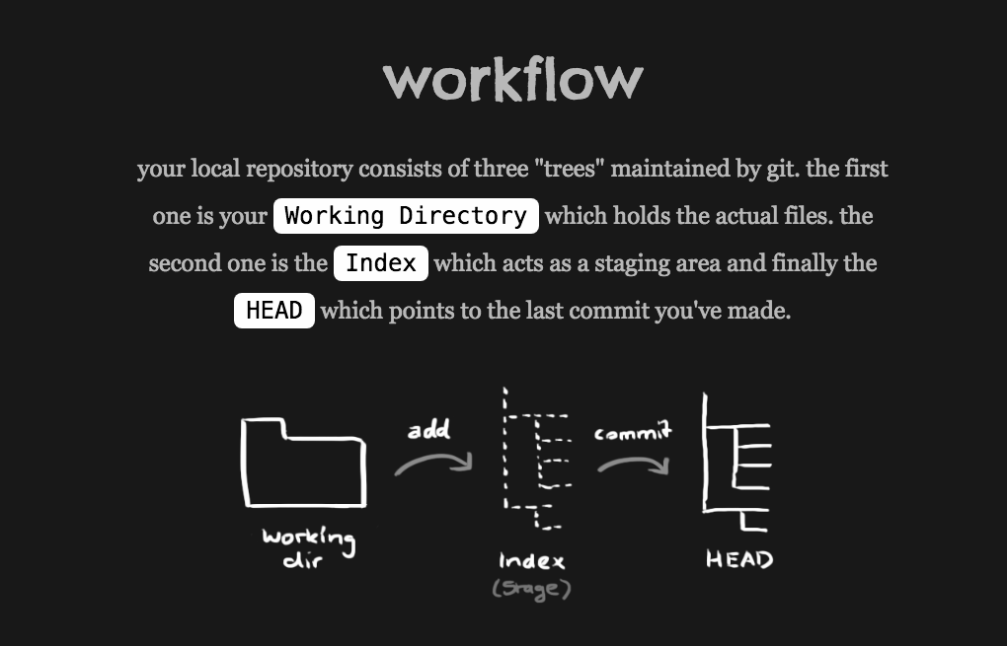

Slide 16
Push your branch
This will upload your branch to the remote named origin (remember, that’s the URL defined initially during git clone).
After a successful push, your teammates will then be able to pull your branch to view your commits
> git push origin <branch_name>

Slide 17
Pull the latest changes
You can pull somebody else’s changes to your local working directory using this command.
It will fetch all the changes to your working directory and merge the changes with your existing changes.
> git pull <remote_name> <branch_name>

Slide 18
View the differences between checkpoints
After editing some files, you can simply type below command to view a list of the changes you’ve made. This is a good way to double-check your work before committing it.
For each group of changes, you’ll see what the file used to look like (prefixed with - and colored red), followed by what it looks like now (prefixed with +and colored green).
> git diff <branch_name> <other_branch_name>

Slide 19
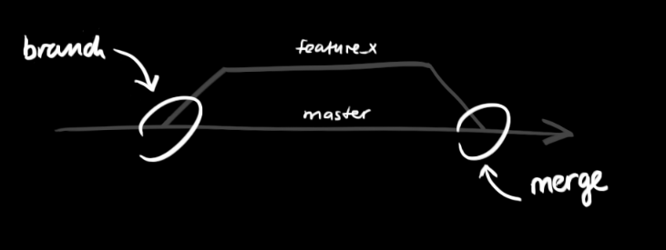
Merge your branch
Once you are completed with the development of a feature/bug, you can merge your branch with the master/staging branch as a release.

Slide 20
Merge your branch (Continued)
> git merge <source_branch_name> <target_branch_name>
Above command will pull all the commits made into your source branch and will merge them with the target branch.

Slide 21
Working with Git Logs
In its simplest form, you can study repository history using git log
You can add a lot of parameters to make the log look like what you want.
To see only the commits of a certain author:
> git log --author=bob
To see a very compressed log where each commit is one line:
> git log --pretty=oneline
See only which files have changed: Seeing the logs in detail:
> git log --name-status > git log --summary

Slide 22


Slide 23
Real time Use Cases

Slide 24
How to Remove Staged files before commit?
Let’s say you have added files to Git that you do not want it to track. In such a situation, you tell Git to stop tracking them.
Running a simple git rm will not only remove it from Git tracking, but will also remove it from your local file system!! To tell Git to stop tracking a file, but still keep it on your local system, run the following command:
> git rm --cached <file_names>

Slide 25
Merge conflicts?
What is a conflict?
During a merge, the working tree files are updated to reflect the result of the merge. Among the changes made to the common ancestor’s version, non-overlapping ones (that is, you changed an area of the file while the other side left that area intact, or vice versa) are incorporated in the final result verbatim. When both sides made changes to the same area, however, Git cannot randomly pick one side over the other, and asks you to resolve it by leaving what both sides did to that area.
Here are lines that are either unchanged from the common ancestor, or cleanly resolved because only one side changed. <<<<<<< yours:sample.txt Conflict resolution is hard; let's go shopping. ======= Git makes conflict resolution easy. >>>>>>> theirs:sample.txt And here is another line that is cleanly resolved or unmodified.

Slide 26
Merge conflicts? (Continued)
How to resolve them?
After seeing a conflict, you can do two things:
Decide not to merge. git merge --abort can be used for this.
Resolve the conflicts. Git will mark the conflicts in the working tree.
Edit the files into shape and git add them to the index.
Use git commit -i -m “Conflict Message” or git merge --continue to seal the deal. The latter command checks whether there is a (interrupted) merge in progress before calling git commit.

Slide 27
Committed wrong files?
( Is push made??)
No, Push is not made.
You might want to discard all the local unpushed commits.
> git reset --hard @{commit_id}
Yes, Push is made.
In this case, you need to reset your HEAD to the point to which you want to revert to, and then push the changes to remote branch.
> git reset --hard @{commit_id}
> git push -u <remote_name> <branch_name>

Slide 28
How to work with multiple Remotes?
Displaying your remotes
To see which remote servers you have configured, you can run the git remote command. It lists the short names of each remote handle you’ve specified.
> git remote
origin
You can also specify -v, which shows you the URLs that Git has stored for the shortname to be used when reading and writing to that remote:
> git remote -v
origin https://github.com/schacon/ticgit (fetch) origin https://github.com/schacon/ticgit (push)

Slide 29
How to work with multiple Remotes? (Cntd.)
Adding Remote Repositories
To add a new remote Git repository as a short name you can reference easily using following command
> git remote add pb https://github.com/paulboone/ticgit
> git remote -v
origin https://github.com/schacon/ticgit (fetch) origin https://github.com/schacon/ticgit (push) pb https://github.com/paulboone/ticgit (fetch) pb https://github.com/paulboone/ticgit (push)

Slide 30
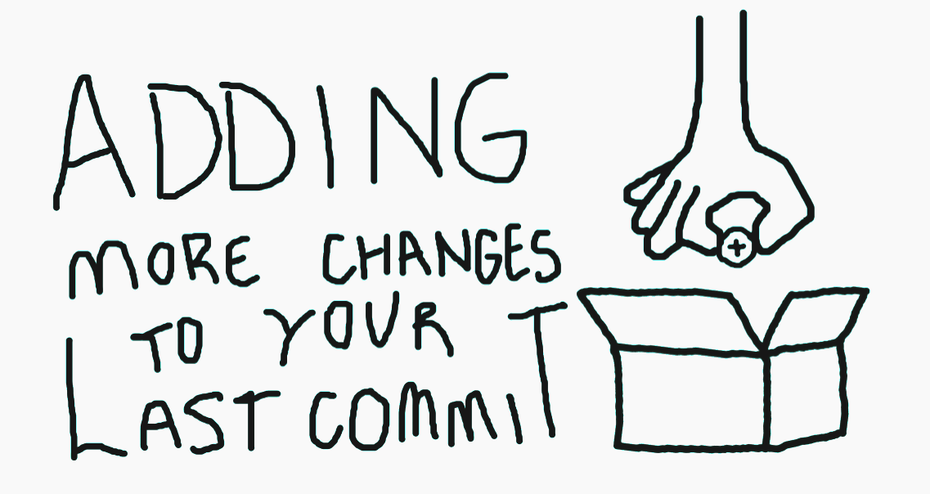
Rewriting History
The below command is a convenient way to modify the most recent commit. It lets you combine staged changes with the previous commit instead of creating an entirely new commit.
It can also be used to simply edit the previous commit message without changing its snapshot. But, amending does not just alter the most recent commit, it replaces it entirely, meaning the amended commit will be a new entity with its own ref.
> git commit --amend

Slide 31
Rewriting History (Continued)
Let’s say, you edited index.html and styles.css files.
You performed following.
> git add index.html (Note that you forgot to add styles.css file)
> git commit
> git add styles.css
> git commit --amend --no-edit

Slide 32
Thank you

